Slide 1
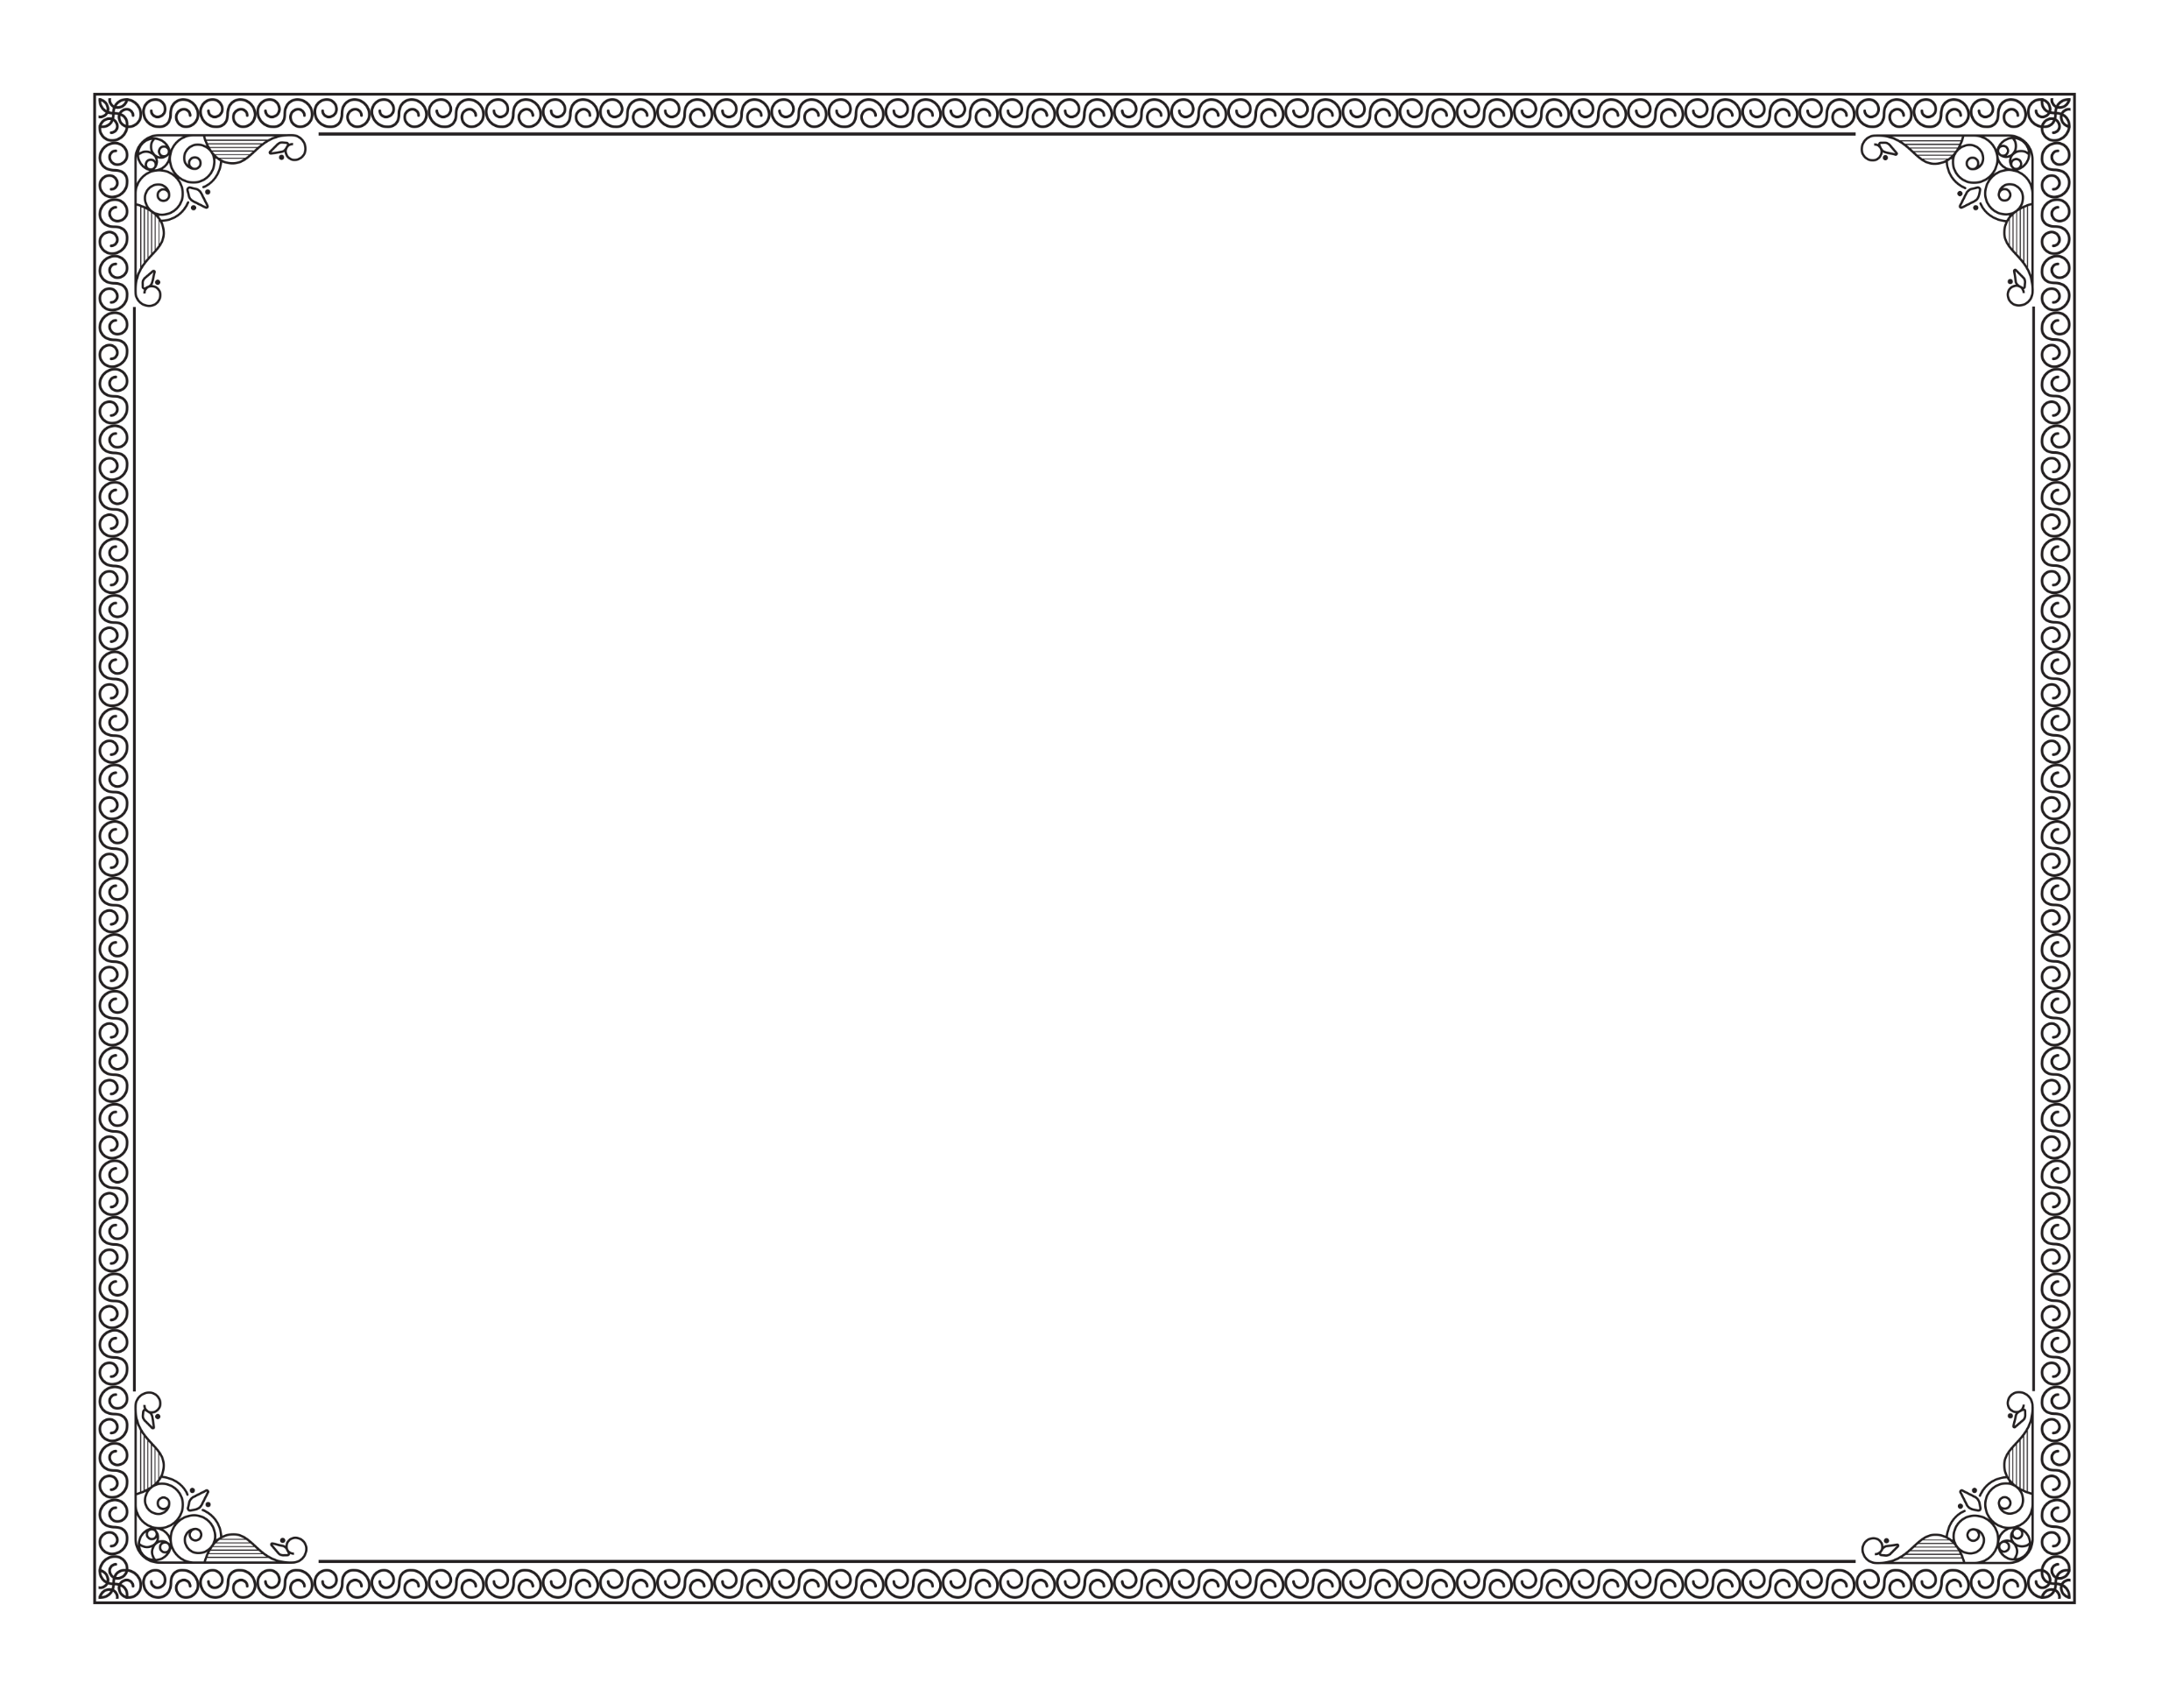

NOTARY CASH FLOW ACADEMY
HEREBY AWARDS THIS
This Proof of Completion shall be valid for a period of two (2) years from the date of issuance and will be retained and secured for a period of two (2) years.
PROOF OF COMPLETION
This Proof of Completion must be attached to the Notary Public application when submitted to the Secretary of State.
TO
(PRINT NAME) |  | (INSTRUCTOR SIGNATURE)
For completing SIX (6) hours of Notary Public training in a curriculum approved by the California Secretary of State
I.D. Type: |  |  | I.D. Number |  | EXP:
Date of Completion: |  |  | Date of Issuance:
Issuing Agency State, County, Country: California, Los Angeles, USA
Vendor Identification Number: ######
INSTRUCTOR SAJID RAZA |  | DATE OF EXPIRATION 2 years from date of issuance |  | LOCATION 7252 REMMET AVE CANOGA PARK, CA 91324

